Slide 1

BLOCKCHAIN
BASED CREDIT SCORING

Slide 2
INTRODUCTION
A credit score is a statistical number that gauges a consumer’s overall ‘creditworthiness’. To determine this, it draws from the consumer’s credit history. Lenders will utilize credit scores as a way to evaluate the probability of an individual repayment of their debts. The typical range of someone’s credit score is from 300 to 850. The higher the score is, the more financially trustworthy a person is in the eyes of lenders.

Slide 3
PROBLEM
For most agencies, credit scoring systems and credit history agencies collaborating are quite convenient. The same cannot be said from the perspective of the users. In the areas where there is a heavy focus on personal data, the matter of safe storage is very urgent.
There was an incident in 2017 that left a lot of people in doubt concerning the safety of their information. Between May and July of that year, hackers stole up to 145 million Americans’ Social Security numbers that contained birthdays, driver’s license numbers, addresses, etc.

Slide 4
The additional data has the potential to make it easier for hackers to open credit lines.
Alternatively, they could go on to exploit the identities of the victims.
Storage that is centralized is completely vulnerable and will be a constant target for hackers.
The large-scale hack of users’ database(~145m) at Equifax is all the confirmation that this belief needs.

Slide 5

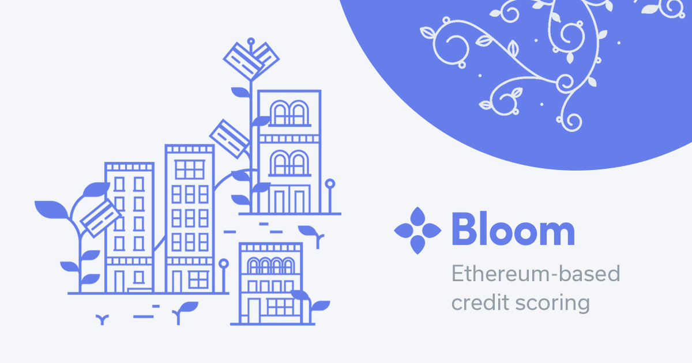
HOW DO WE TACKLE IT?
Blockchain and cryptographic technologies alike have the capability of providing much better protection for vital information.
In addition, credit scoring is an easily solvable issue for such systems. Moreover, there exists companies in which credit issuance also fully operates on the blockchain.

Slide 6
OVERVIEW OF THE PROJECT
A transaction here consists of the entities: lender, borrower, loan amount, hash value of the previous block, hash value of the current block.
Whenever a borrower registers into the decentralised blockchain interface, he uploads the y function of his credit score. This ensures the privacy of his credit score (sensitive data).
Whenever a borrower tries to make a new transaction, his identity is verified by the interface through zero-knowledge proof (verifyTransaction()), using the y value uploaded by the borrower when he registered for the first time.
After that, the borrower must solve proof of work (decrypt the hash value, in this case) successfully to become eligible to mine a block (mineBlock()).

Slide 7
The lender can log in to the interface any time and can approve one of available eligible transactions. Once a transaction is approved, a block is successfully mined in the name of the respective borrower, and the block is added to the blockchain database (createBlock()).
Once the block is added to the blockchain database, it is immutable. Hence, the blockchain database successfully secures the transaction records and makes it impossible to alter or falsify the records.
In this way, the blockchain interface successfully acts as a decentralised medium in which both lenders and borrowers can log in and add blocks of properly approved transactions to the blockchain database.
The lenders and the borrowers can check their previous transactions any time (viewUser()).

Slide 8
verifyTransaction()
Whenever a borrower tries to make a new transaction, his identity is verified by the interface through zero-knowledge proof (verifyTransaction()), using the y value uploaded by the borrower when he registered for the first time.

Slide 9
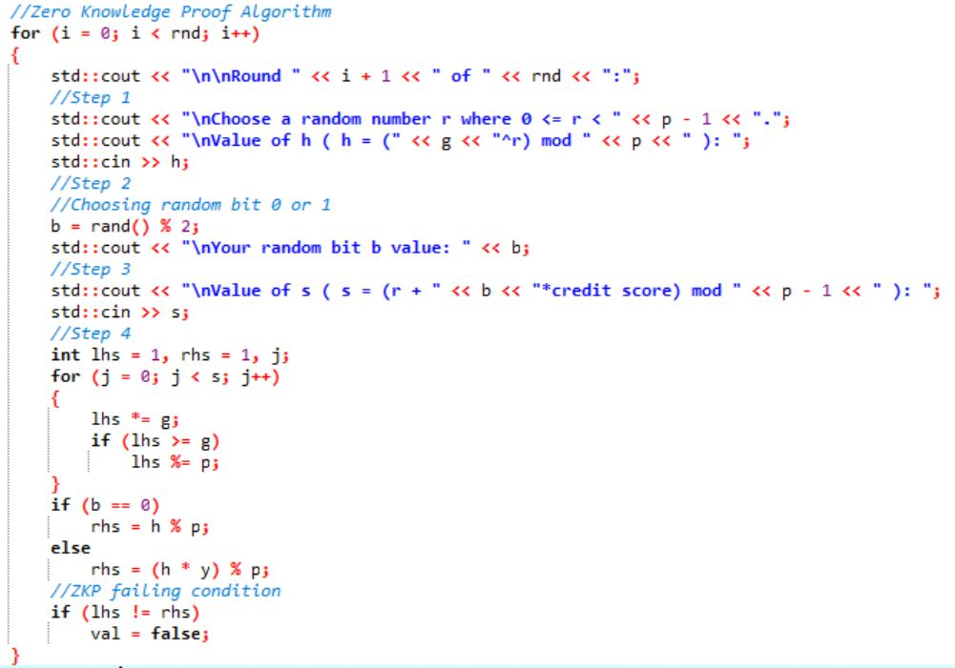
The zero-knowledge proof loop in verifyTransaction():

Slide 10
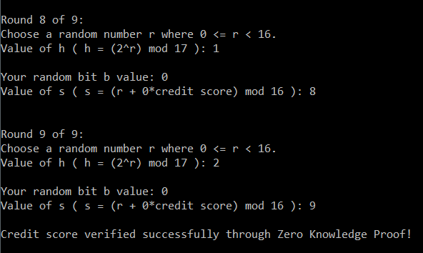
verifyTransaction(): Success

Slide 11
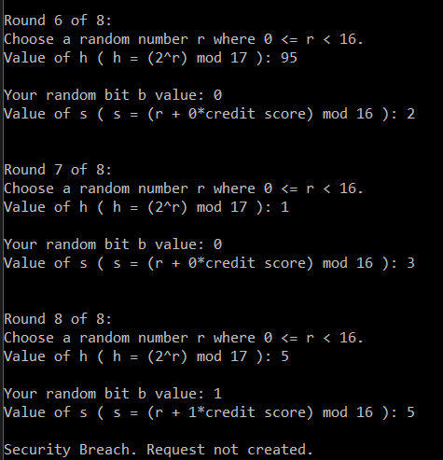
verifyTransaction(): Failure

Slide 12
mineBlock()
The borrower must solve proof of work (decrypt the hash value, in this case) successfully to become eligible to mine a block (mineBlock()).

Slide 13
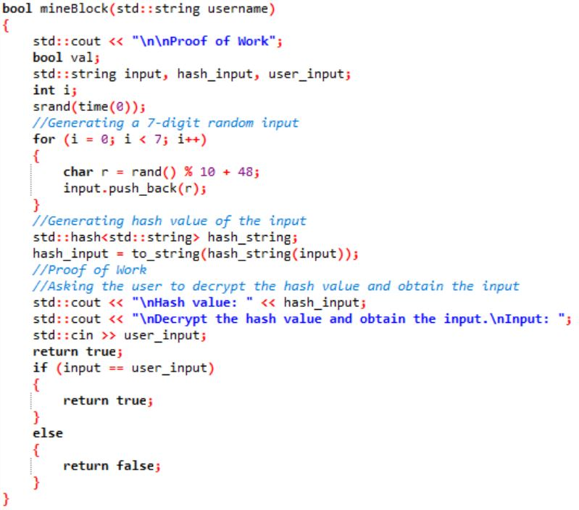
mineBlock() function:

Slide 14
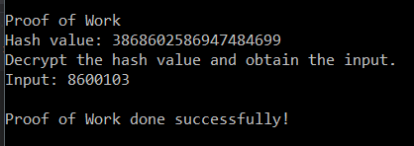
mineBlock(): Proof of work success

Slide 15
createBlock()
The lender can log in to the interface any time and can approve one of available eligible transactions. Once a transaction is approved, a block is successfully mined in the name of the respective borrower, and the block is added to the blockchain database (createBlock()).

Slide 16
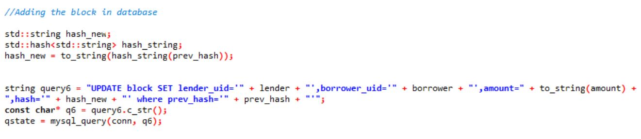
A code snippet of createBlock() to add block in blockchain database:

Slide 17
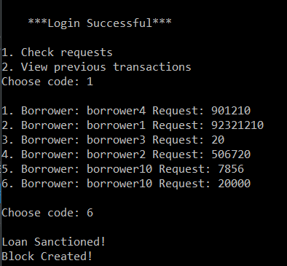
createBlock() success:

Slide 18
viewUser()
The lenders and the borrowers can check their previous transactions any time (viewUser()).

Slide 19
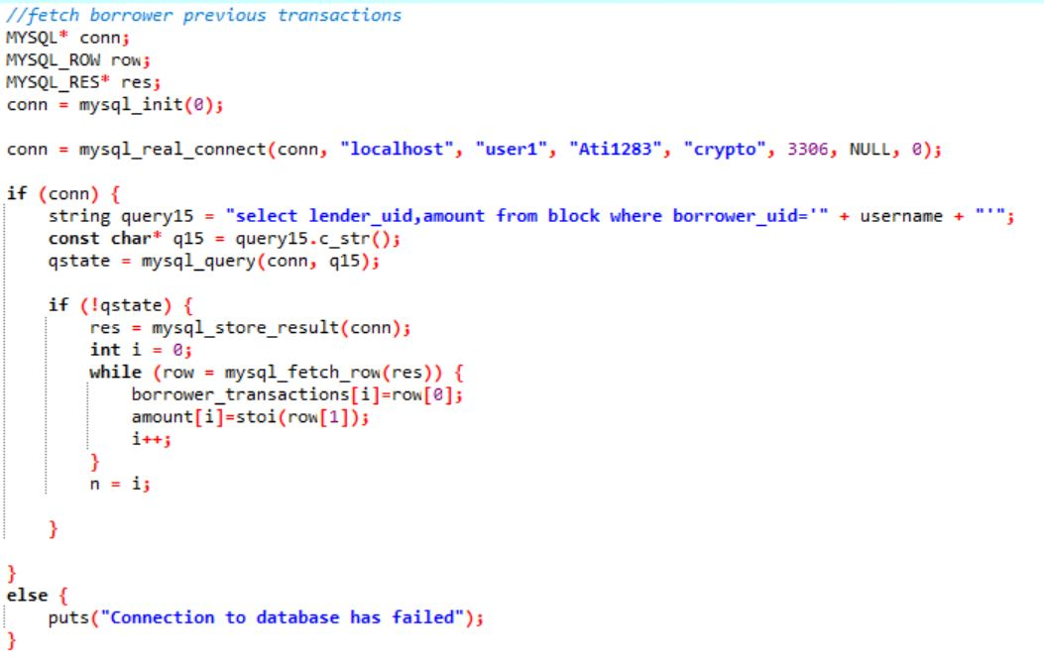
A code snippet of viewUser() to fetch the previous transactions of a borrower from the database:

Slide 20
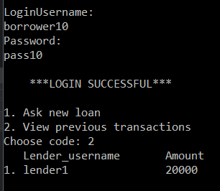
viewUser(): Previous transactions of a borrower

Slide 21
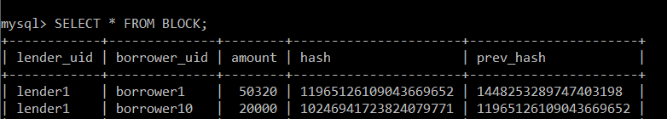
DATABASE TABLES
Blockchain Table

Slide 22
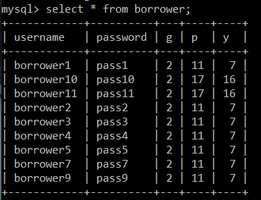
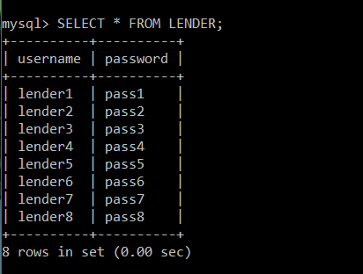
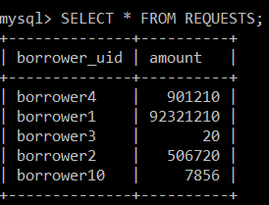
Request Table
Borrower Table
Lender Table

Slide 23
CONCLUSION
This project has been instrumental in understanding and learning the concept of blockchain, meanings of various new terms like zero-knowledge proof, proof of work, etc.
We also learnt how to successfully implement blockchain and use it to solve real-life problems like security of credit scores and decentralisation of loan transactions.

Slide 24
TEAM 14
Atishya Gupta - 2017A7PS1482H
V Rachana Srikruthi - 2017A7PS0086H
V Chandrahaas - 2015A7PS0010H
R Hariharan - 2017A7PS0065H

Slide 25
THANK YOU!

